Slide 1
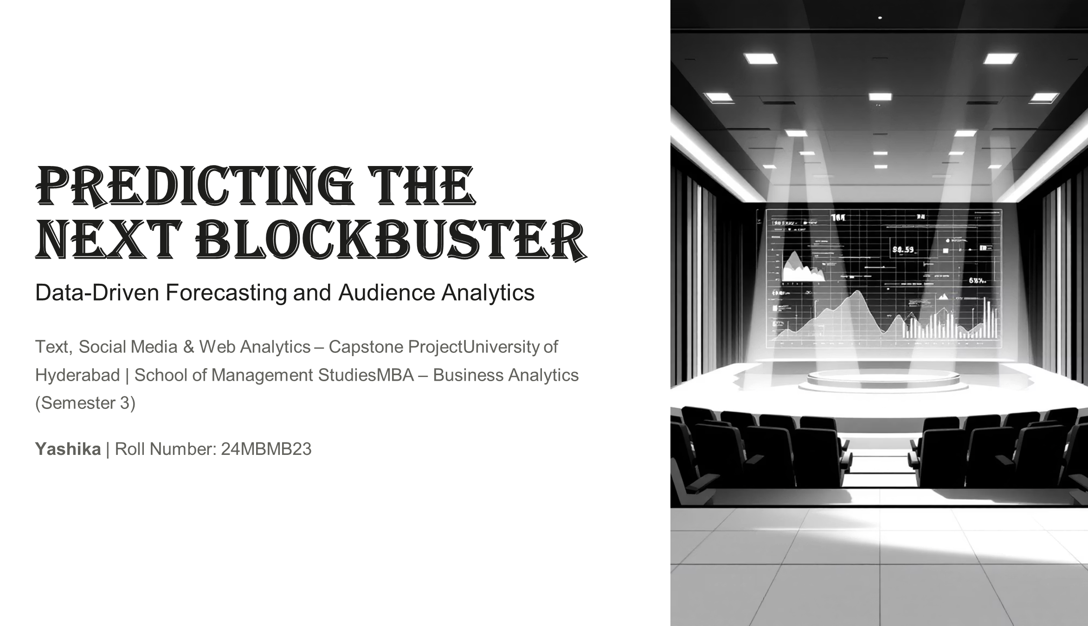

Slide 2
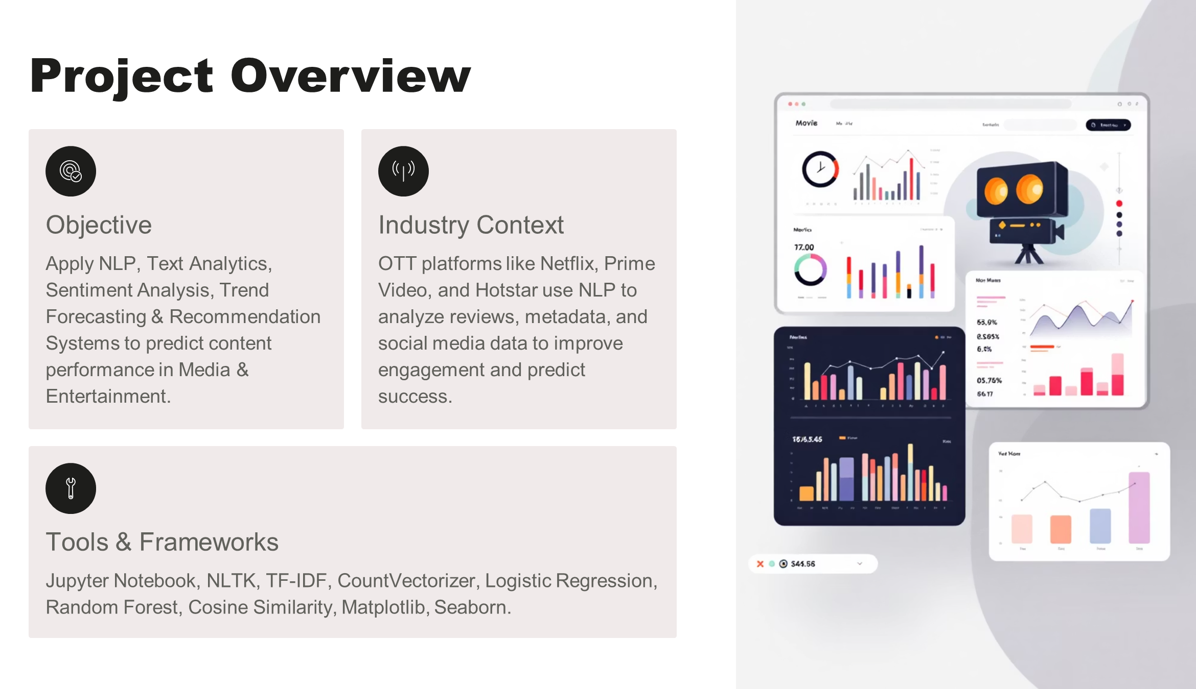

Slide 3
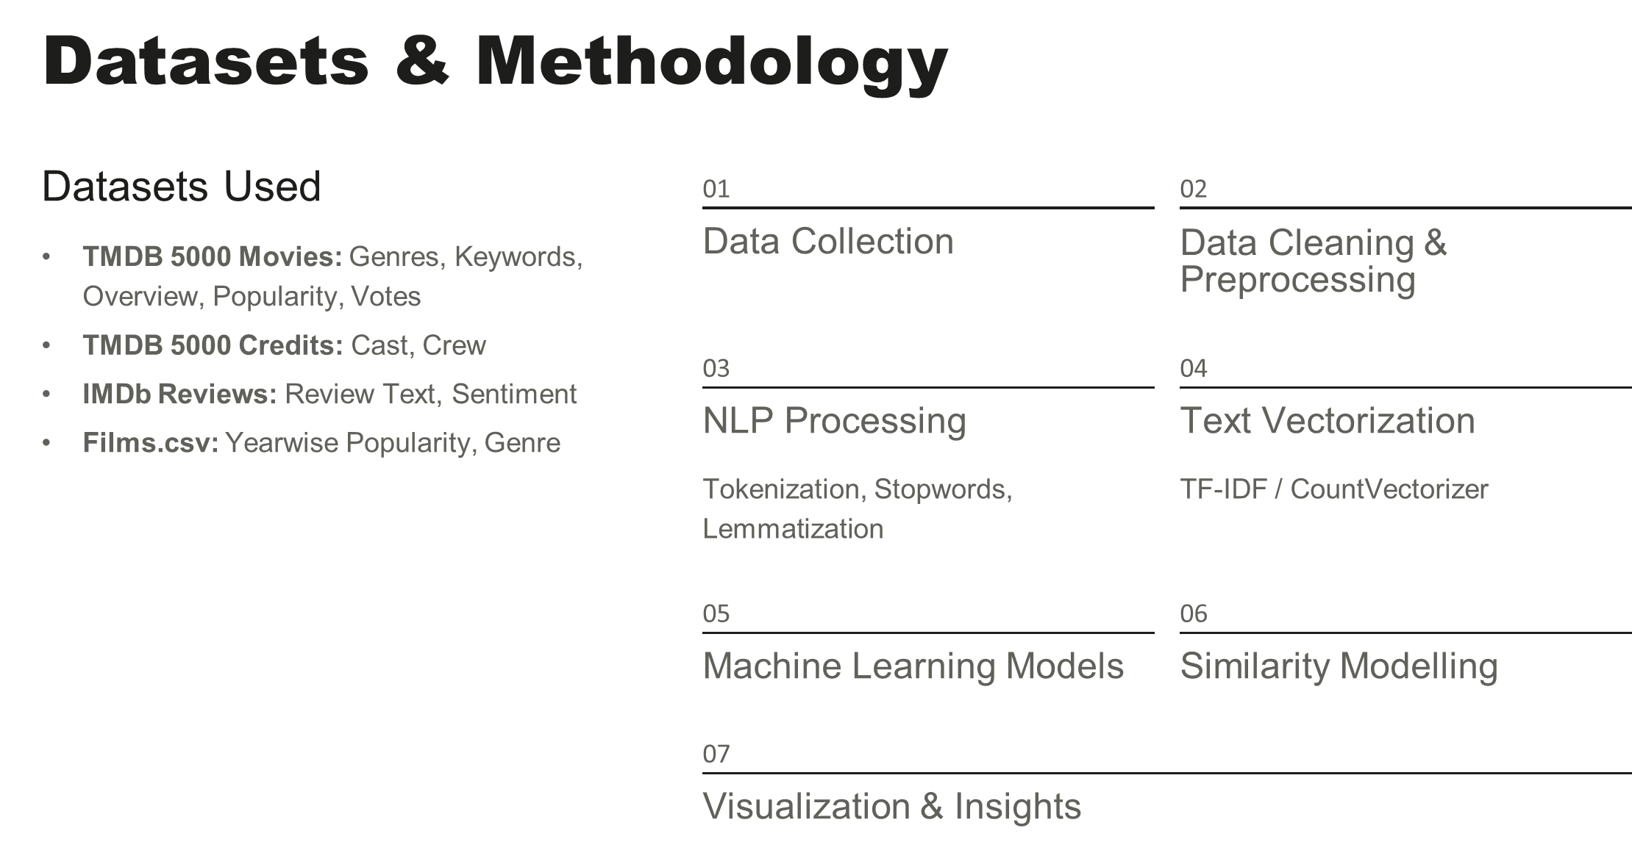

Slide 4
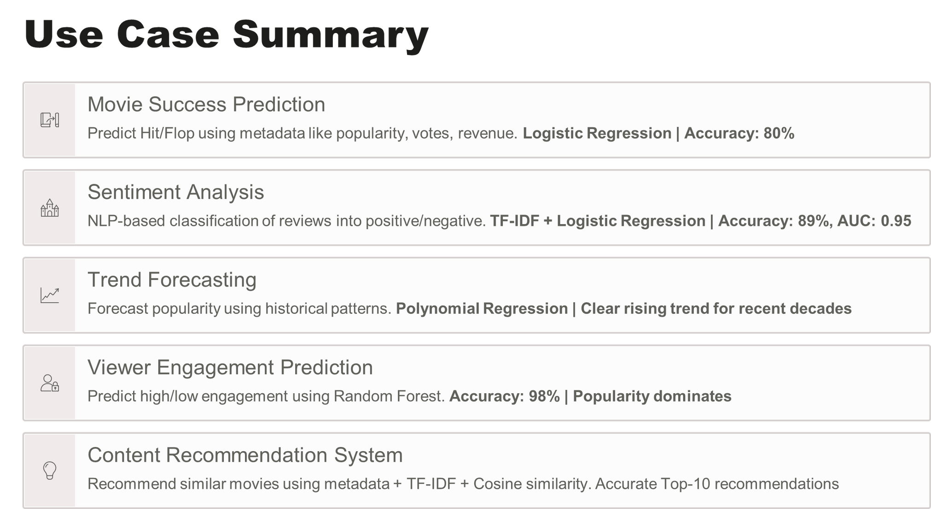

Slide 5
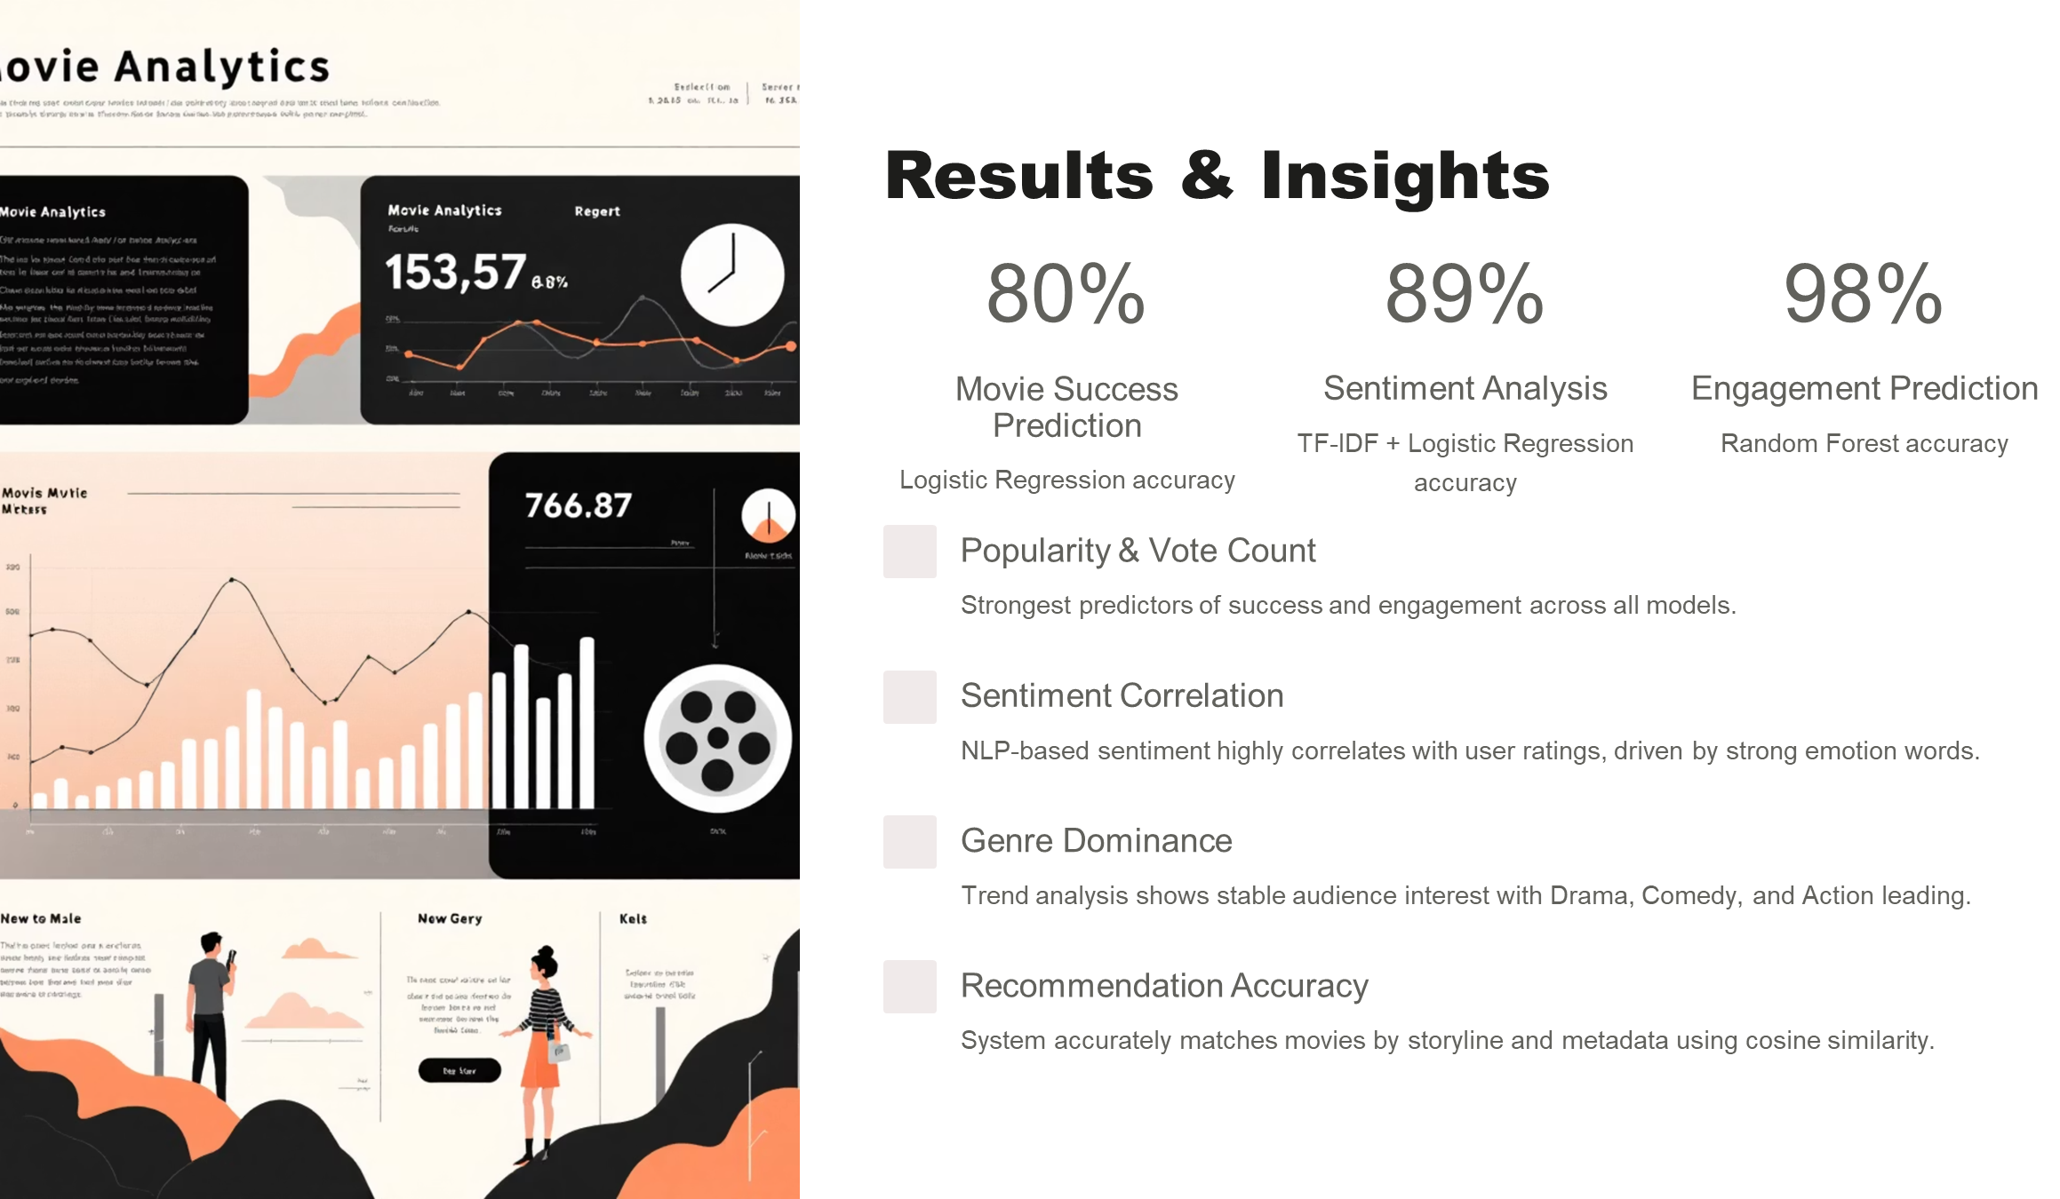

Slide 6
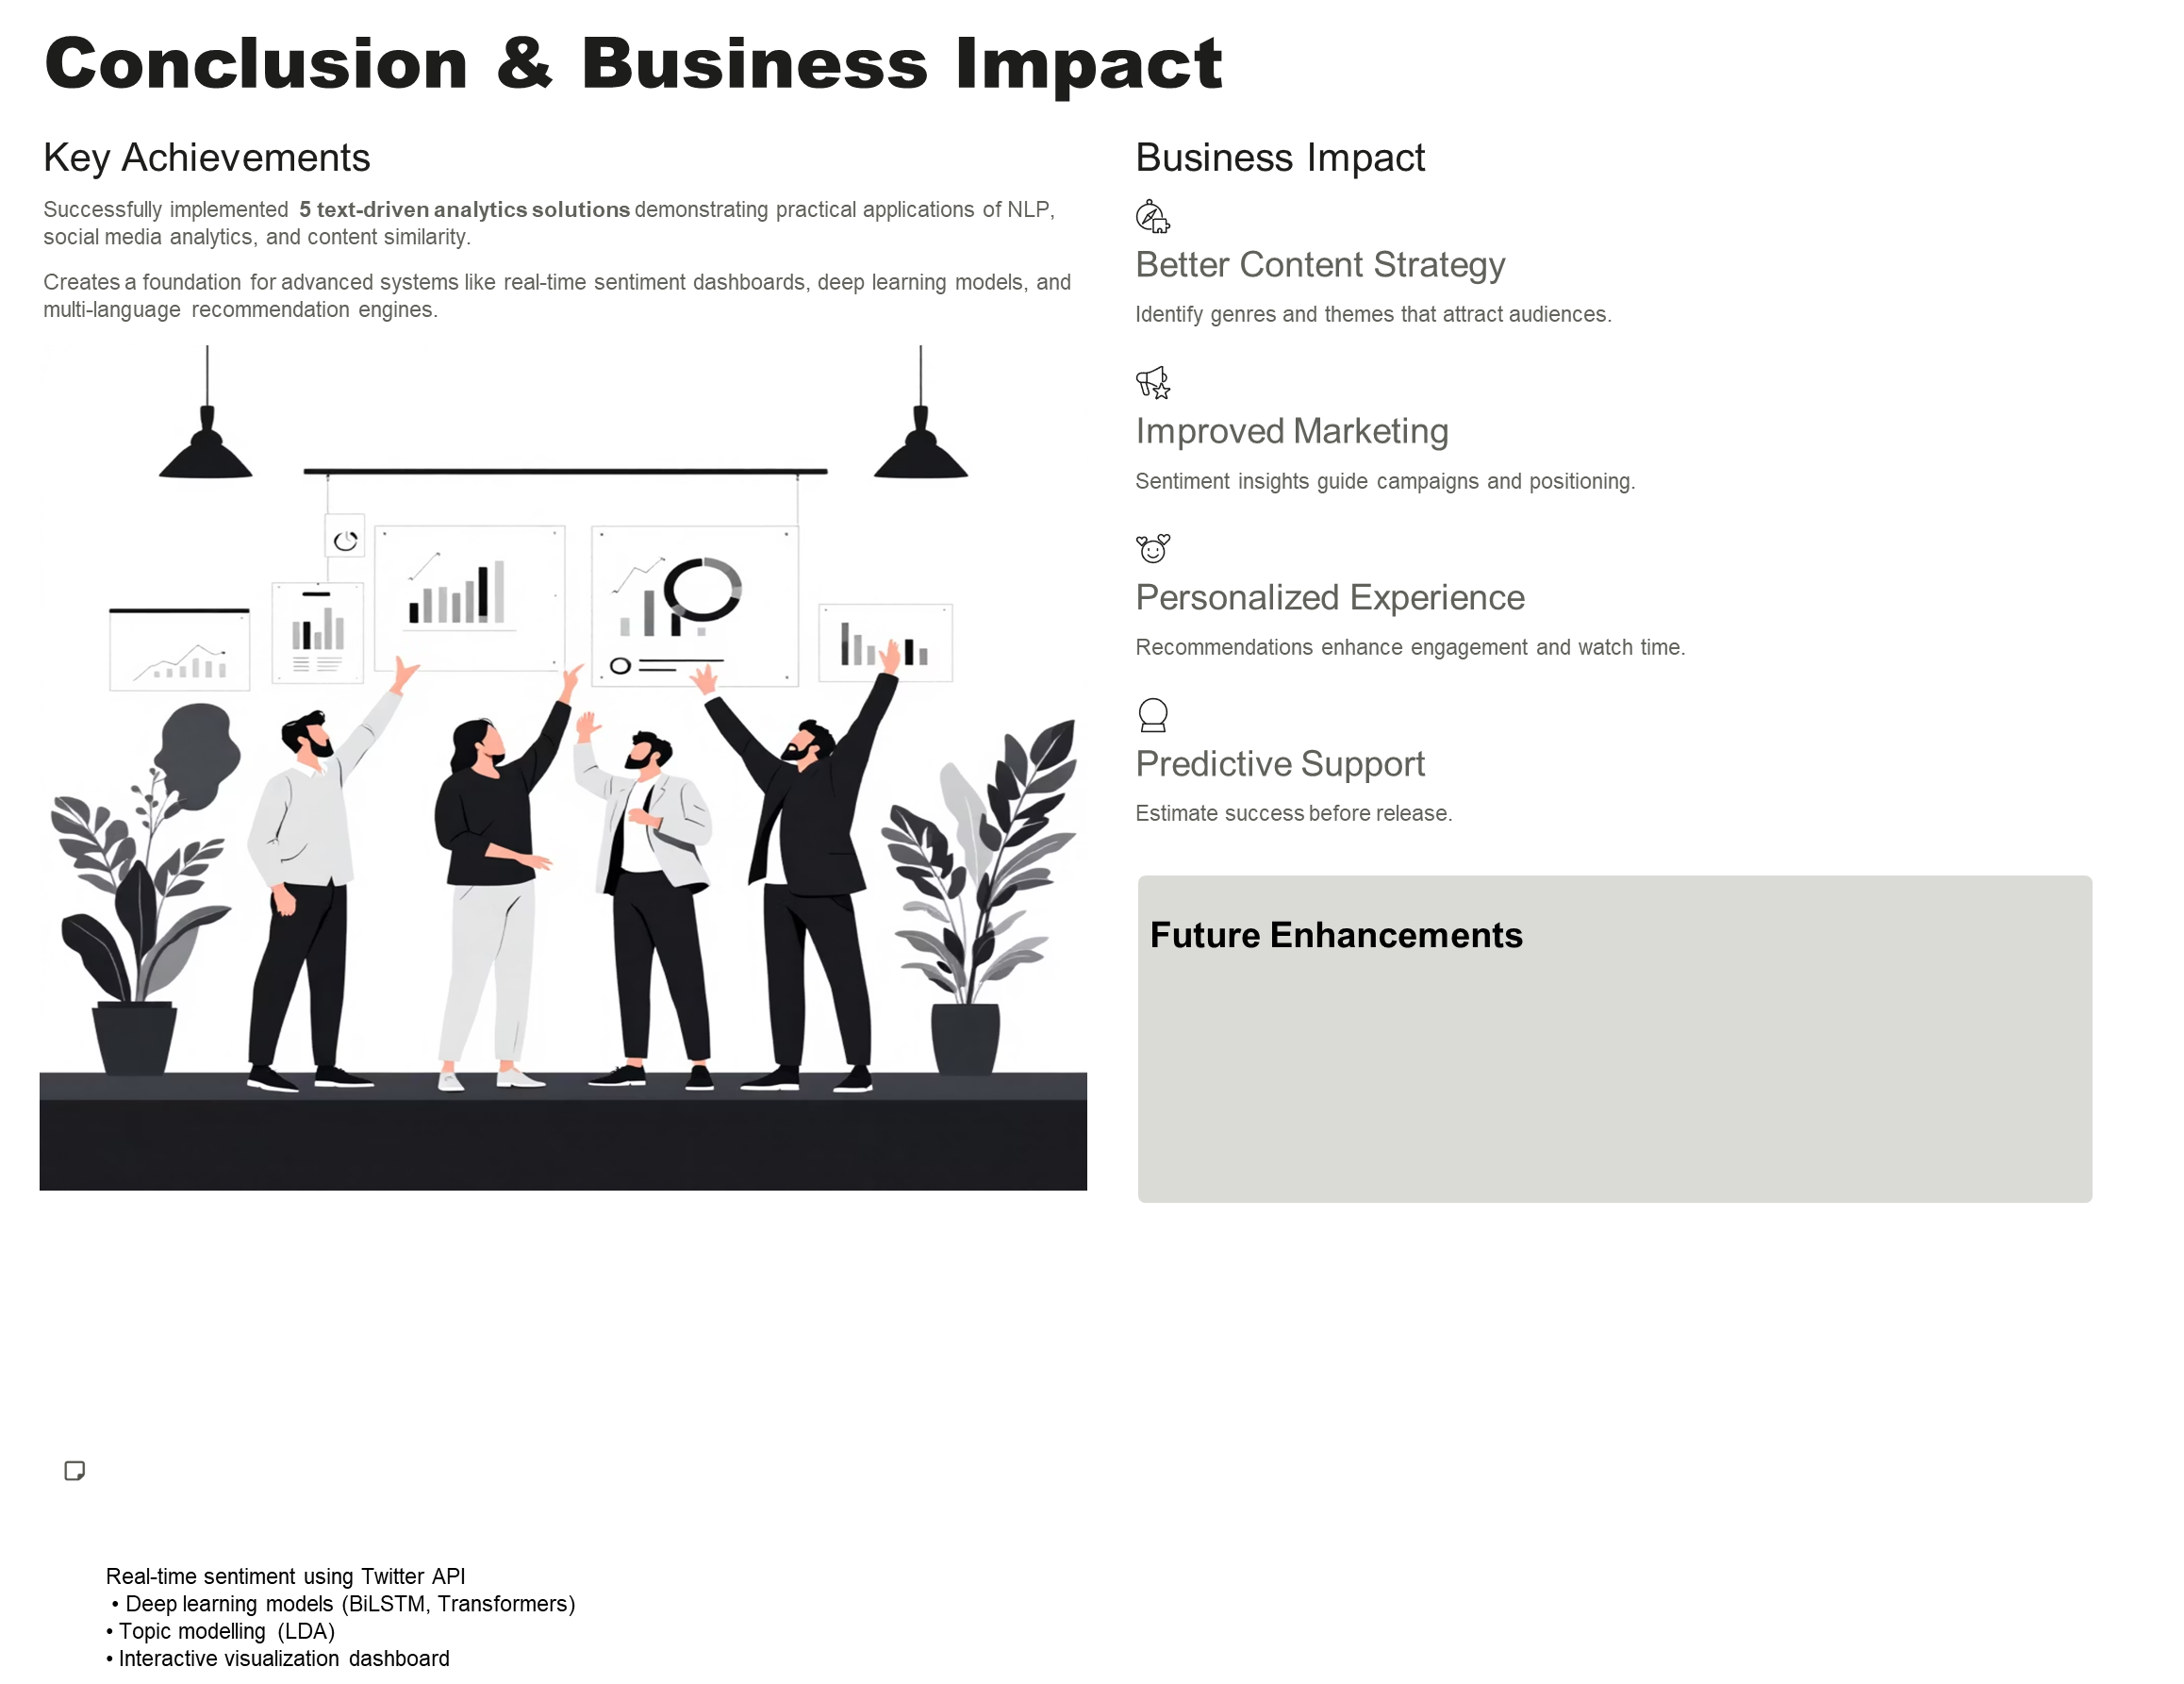
Real-time sentiment using Twitter API
• Deep learning models (BiLSTM, Transformers)
• Topic modelling (LDA)
• Interactive visualization dashboard

